Slide 1
Kindness Week
January 25th – January 29th

Slide 2
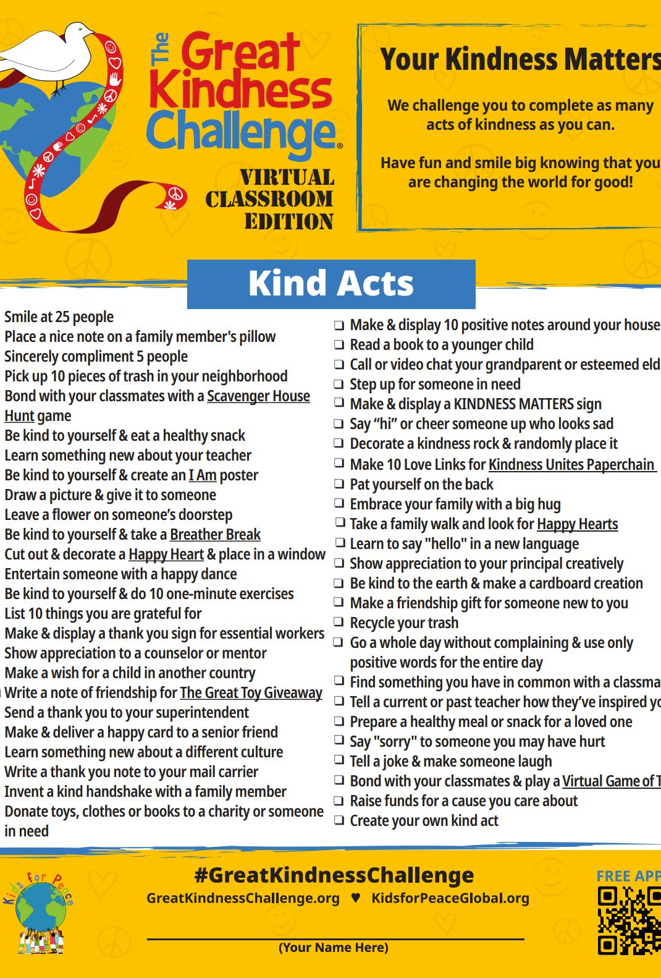
The Great Kindness Challenge Checklist
Received during 1st Period
1 student from each grade level with the most checked off the checklist by Friday, January 29th will win a $10.00 Chick Fil A gift card
The checklist MUST BE SIGNED BY AN ADULT & TURNED IN TO THE FRONT OFFICE BY 3 PM ON FRIDAY, JANUARY 29TH
Please reach out to Ms. Rubio for any questions

Slide 3
Kindness Video
https://www.youtube.com/watch?v=mTsvSAItPqA&t=4s

Slide 4
Go Out & Be Kind

