Slide 1
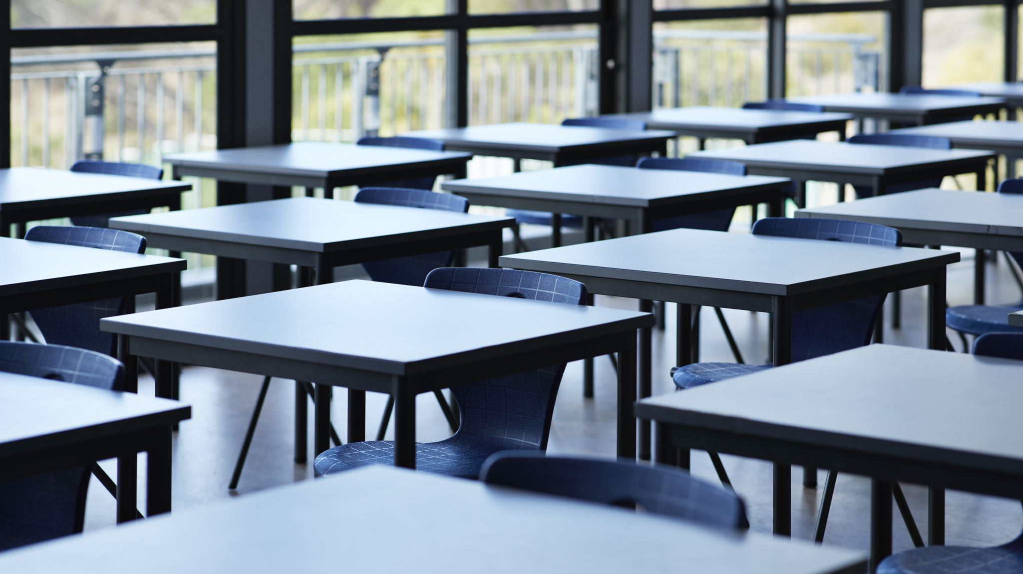
Respect in a Classroom Setting
September 30th, 2020

Slide 2
What are some examples of showing respect in a classroom setting?

Slide 3
Video
https://safeYouTube.net/w/hSQhb
Please start video at :45 sec.

Slide 4
Discussion
What are some examples that stood out to you the most?
Why is it important to show RESPECT in a learning environment?

