Slide 1
Respect
September 2020

Slide 2
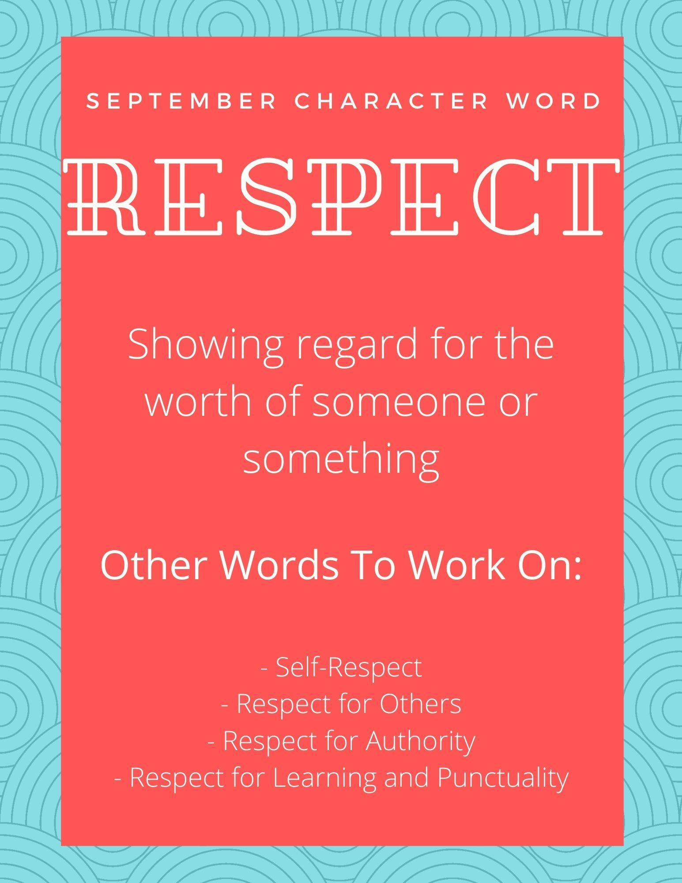
Character Word of the Month

Slide 3
How do you show respect to others in your life? Why is respectful behavior important in society?

Slide 4
Video
https://mcsd.connectwithkids.com/character-life-skills/
(Click the link above and scroll down to the 7TH video on the RIGHT to access the RESPECT video

Slide 5
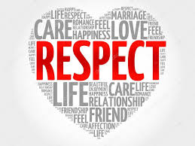
What stood out to you from this video? Why do you think the title of this video was Respect? What kinds of respect (and disrespect) did you see or hear discussed? One of the students at the end said that Theresa didn’t have respect for herself, so she believed it when her boyfriend didn’t have respect for her. Another student said that it wasn’t that she didn’t respect herself, it was that she believed her boyfriend could be better. What do you think?

