Slide 1
What is PBIS?
Positive behavioral interventions and supports (PBIS) is a way for schools to encourage good behavior.
With PBIS, schools teach kids about behavior, just as they would teach about other subjects like reading or math.
The focus of PBIS is prevention, not punishment.

Slide 2
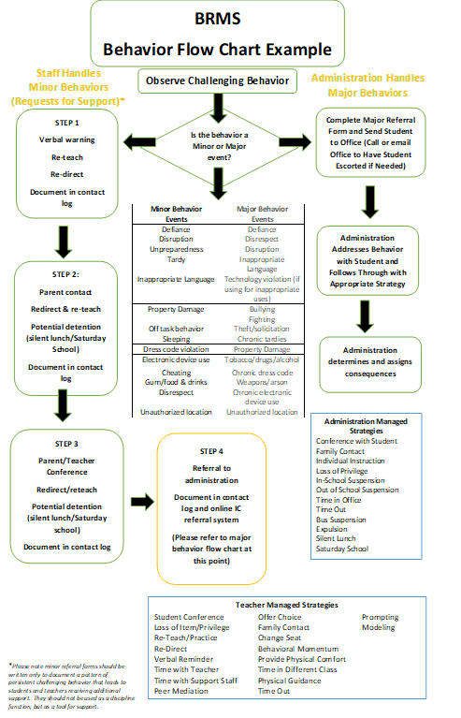
Flowchart
The STEP system is still in place! Starting next school year… Steps will not start over each semester.

Slide 3
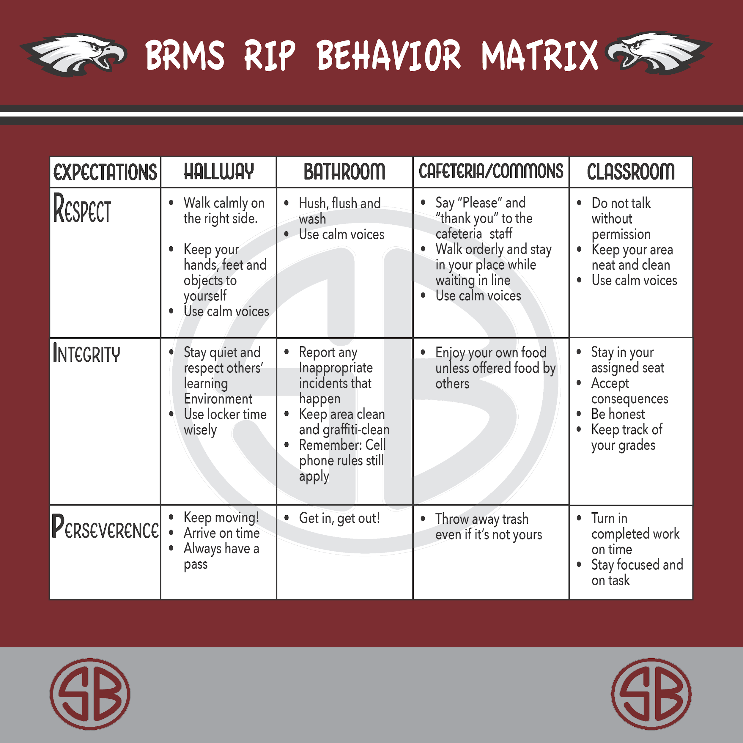
Matrix

Slide 4
respect
Hallway | Bathroom | Cafeteria/ commons | classroom
Right | Right | Right | Right
Wrong | Wrong | Wrong | wrong

Slide 5
integrity
Hallway | Bathroom | Cafeteria/ commons | classroom
Right | Right | Right | Right
Wrong | Wrong | Wrong | wrong

Slide 6
perseverance
Hallway | Bathroom | Cafeteria/ commons | classroom
Right | Right | Right | Right
Wrong | Wrong | Wrong | wrong

Slide 7
School Wide Student/Teacher Incentive Plan
Principal’s 100 Club
Eagle Growth Challenge

Slide 8
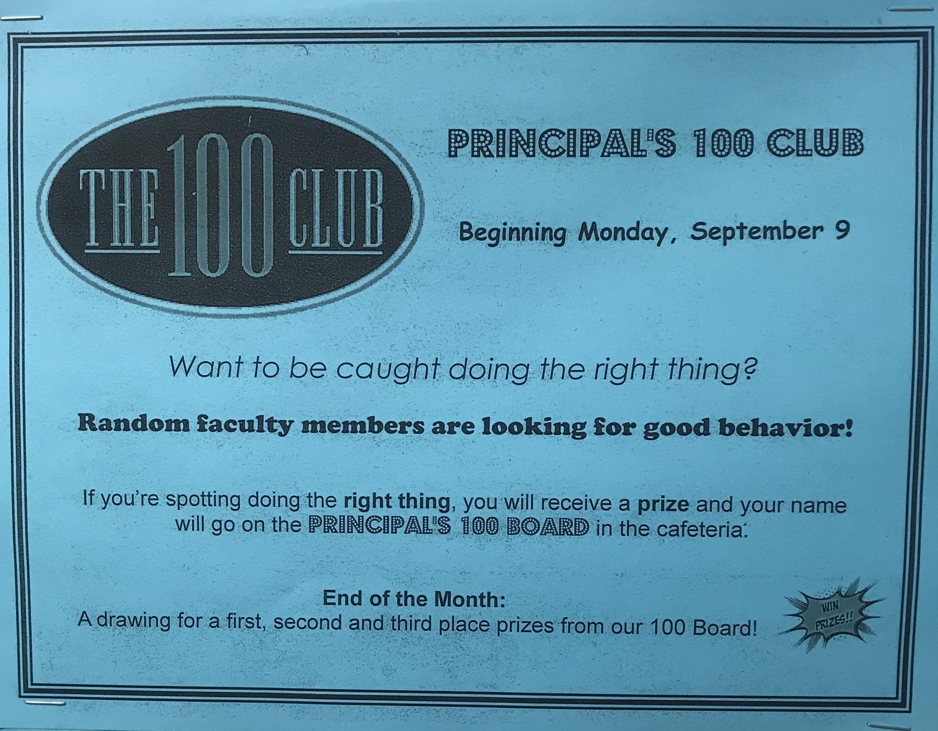

Slide 9
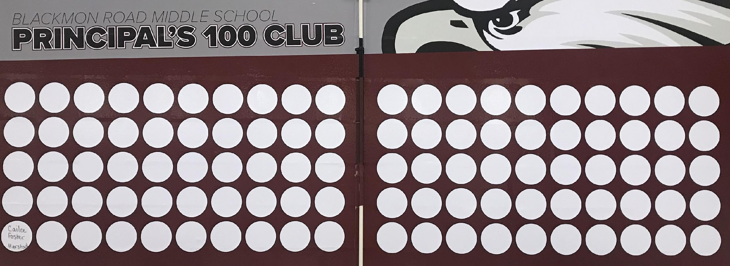

Slide 11
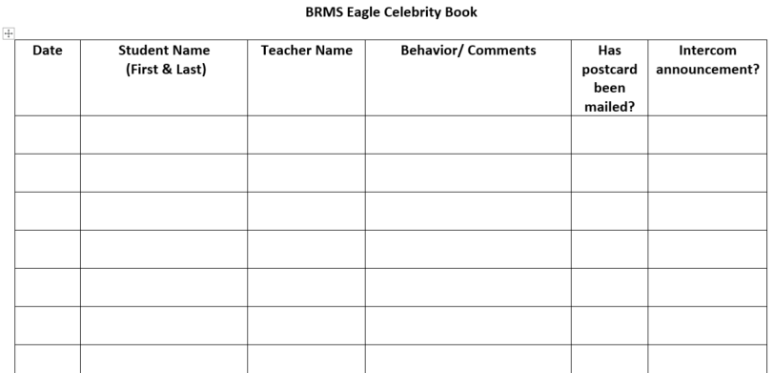

Slide 12
Rip reward ticket options may include…
Free Article of the Week
Free HW pass
Free Admission to a HOME sporting event
Free Admission to a school dance
Free Admission to a Fine Arts performance

Slide 13
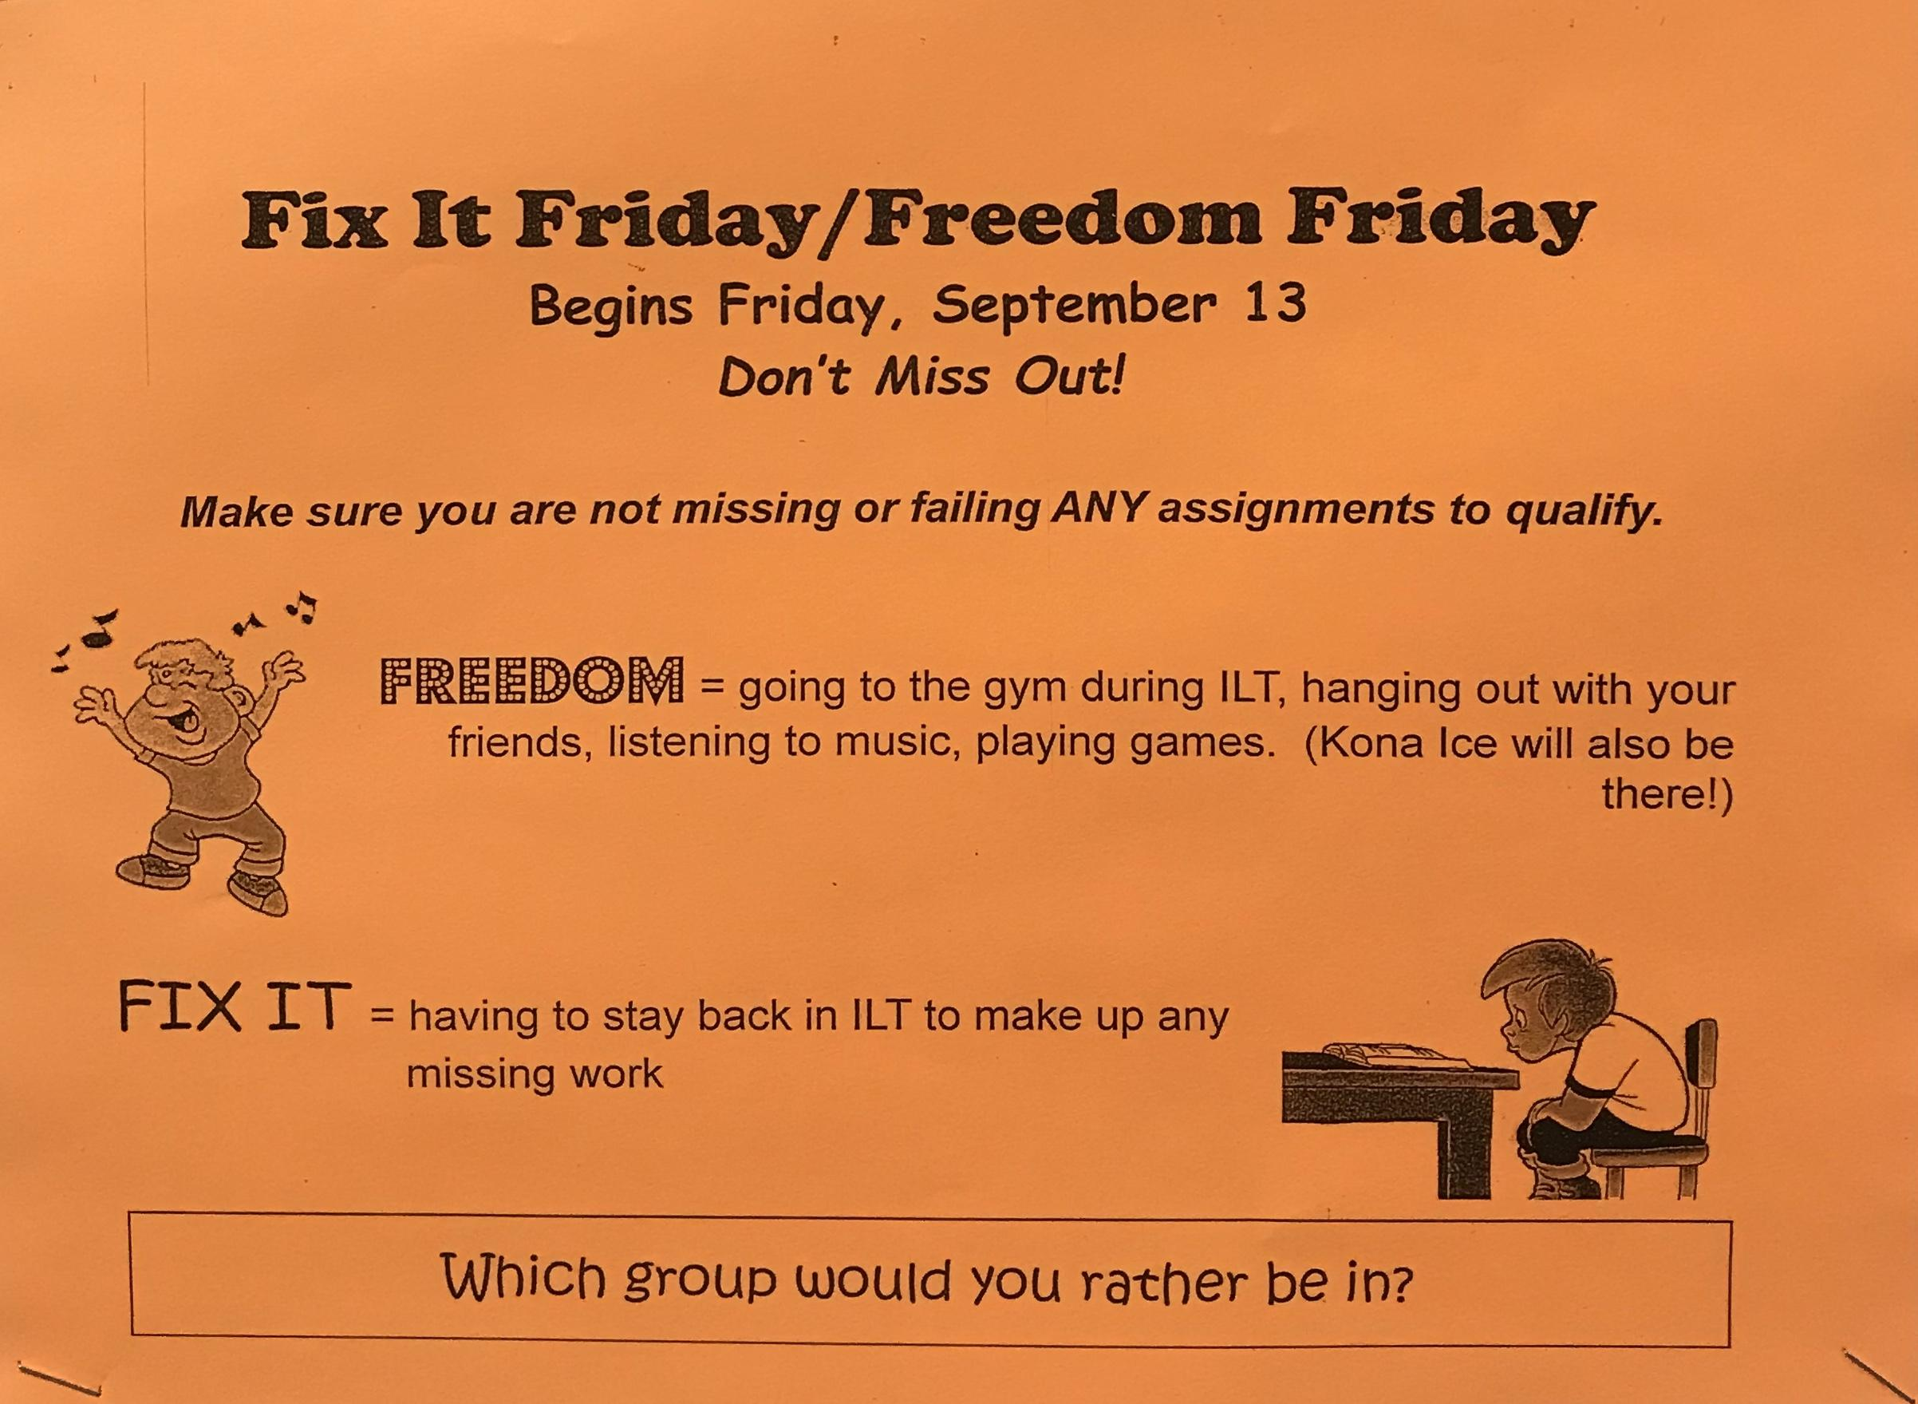

Slide 14
Eagle Growth challenge

Slide 15
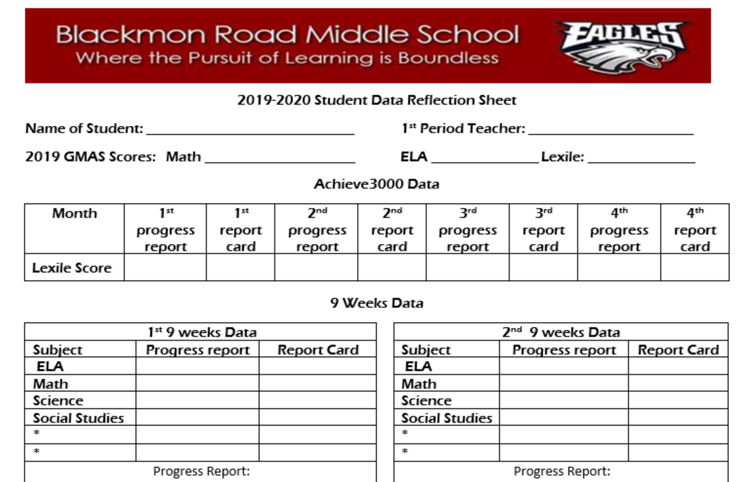

Slide 16
Student Questions
What does RIP stand for? Respect, Integrity, Perseverance)
What areas are on the school wide matrix?
What do the rules look like in that area/setting?
When was the last time you received PBIS points?
Do you know why the points were given?
What rewards do you receive for earning points?
Do you remember a teacher having a lesson on the matrix?

Slide 17
Teacher Questions
-Have you taught the school wide expectations?
- When was the last time you gave a RIP ticket?
-Do you know you have a school-wide team to address behavior/discipline across the campus?
- Have you seen discipline data?
- What does RIP stand for?
- What areas do we have on our Matrix?

