Slide 1
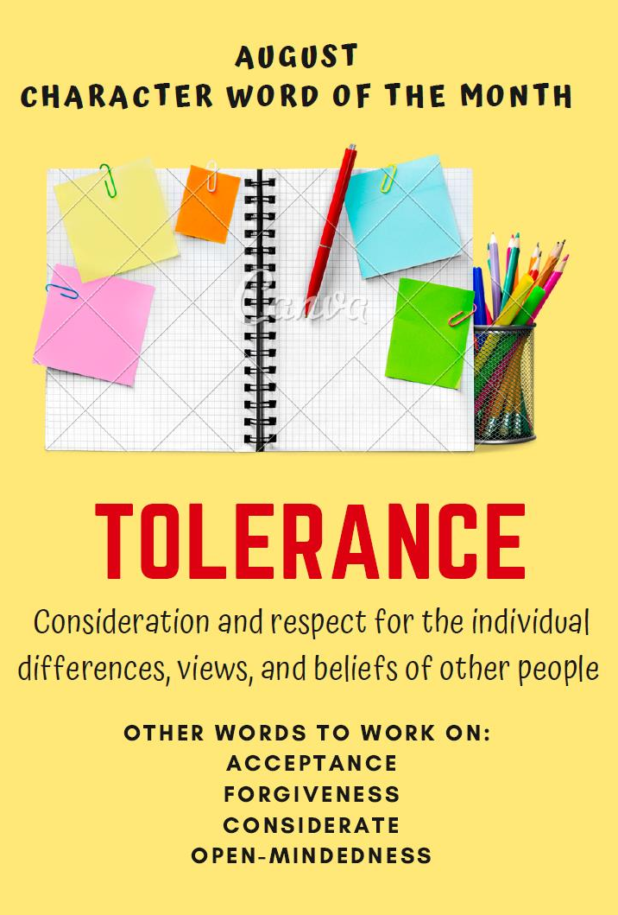
Open Mindedness
To learn tolerance and acceptance through exposure to cultures, ways of life and ideas other than their own

Slide 2
Discussion
How does Open Mindedness relate to our Character Word of the Month, TOLERANCE?
What is one way you can show “Open Mindedness” to a classmate/friend?
Has there ever been a personal experience where someone has not shown “Open Mindedness” to you and your family culture?
How did it make you feel?
How did you address it?

