Slide 1
Mental Health
While Staying at Home

Slide 2
#1 – Establish a Routine

Slide 3
Structure
Daily Routine
Sleep Schedule
Structure is key to a healthy brain.
Create a schedule of activities that you will follow each day.
Go to sleep and wake up at the same time each day.

Slide 4
#2 – Stay Active & Exercise
This Photo by Unknown Author is licensed under CC BY-SA-NC

Slide 5
Exercise helps to create endorphins in our brains, which makes us feel happier.
Go for a Walk
Yoga or Pilates
Run on a Treadmill

Slide 6
#3 – Go Outside

Slide 7
Sunlight Helps!
Sunlight helps to regulate our circadian rhythms – our brain’s way of knowing when it is time to wake up and when it is time to go to sleep. Sunlight also improves mood!

Slide 8
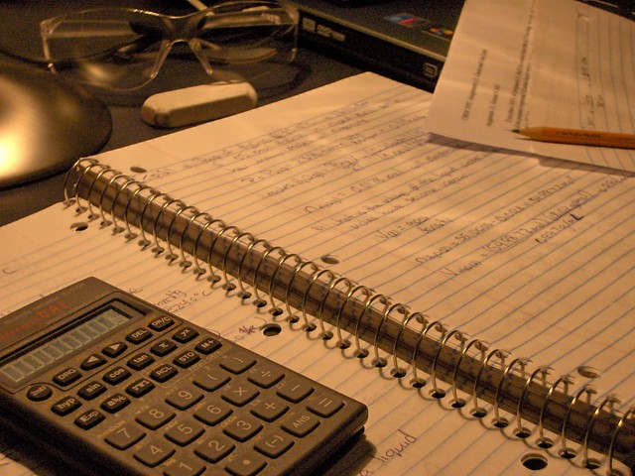
#4 – Do Your Homework!
This Photo by Unknown Author is licensed under CC BY-SA

Slide 9
Why should we do homework?
Stay Mentally Active
Get Ahead, Not Behind
Productivity
Having to think about problems and solutions is good for our brains. If we never use our critical thinking skills, our brains will not function at their best!
Someday we will return to school, and it will be better to be ahead on your schoolwork! If you get behind, it will just make things worse. This is the perfect opportunity to get caught up on your work.
You will likely feel better if you feel like you have accomplished something or worked toward a goal at the end of each day.

Slide 10
#5 – Stay Organized

Slide 11
cluttered room = cluttered mind!
Our environment affects the way we feel!

Slide 12
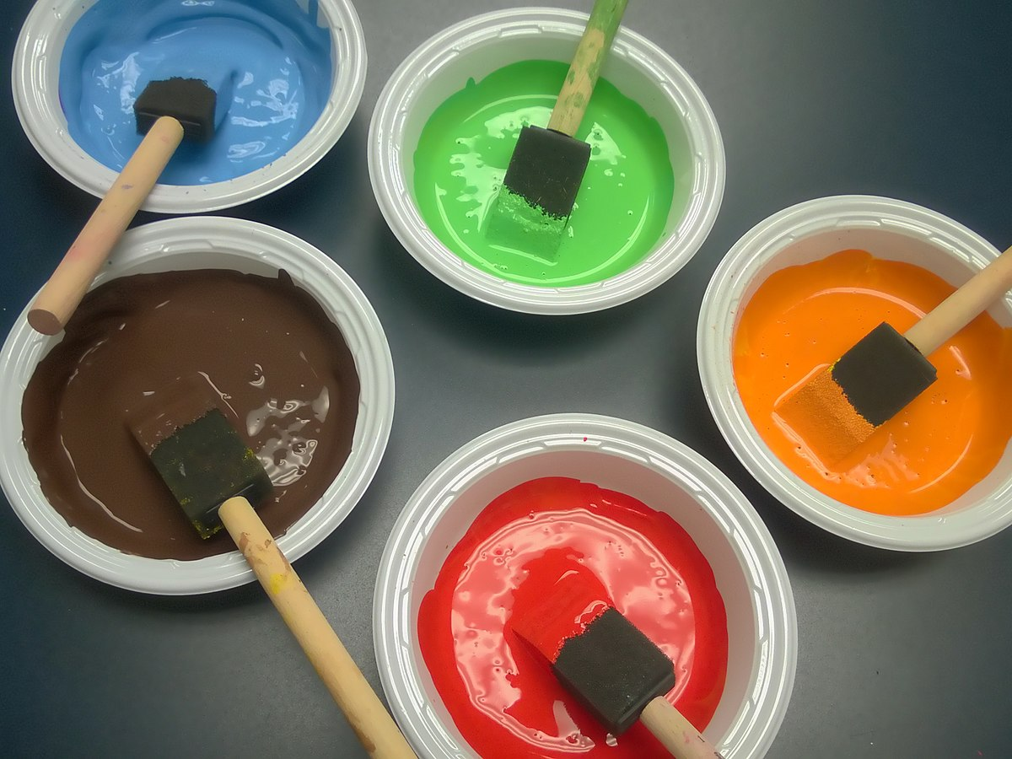
#6 – Do Something Creative
This Photo by Unknown Author is licensed under CC BY-SA

Slide 13
Creative Ideas
Artwork
Music
Photography
Writing
Makeup
Cooking
Draw or paint to express your feelings.
Play an instrument or write a song.
Take pictures of your surroundings.
Write a creative story or write poetry.
If you enjoy doing hair and makeup, it can be a fun creative activity.
Try some new recipe ideas. Bake cookies!

Slide 14
#7 – Keep a Journal

Slide 15
Express your Feelings
It will be fun to look back on your journal in a few years!

Slide 16
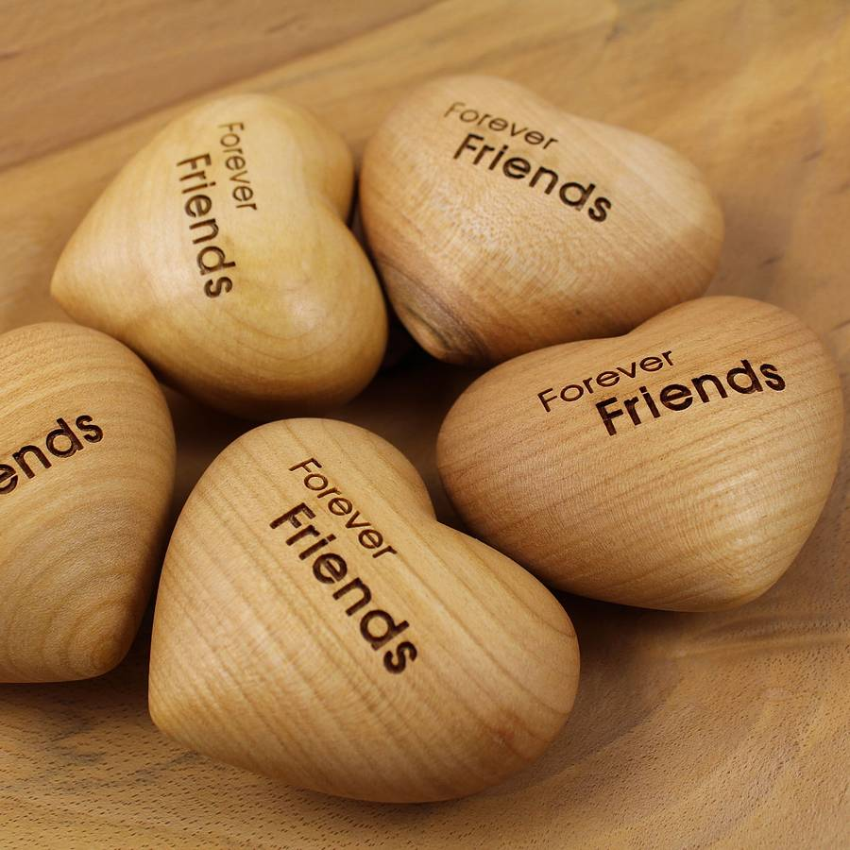
#8 – Reach Out to Others
This Photo by Unknown Author is licensed under CC BY-ND

Slide 17
Communicate with Friends & Family
01
03
Phone Call
Email
02
04
Facetime or Skype
Text

Slide 18
#9 – Eat Healthy

Slide 19
Eat fruits, vegetables, and protein. Avoid junk foods!

Slide 20
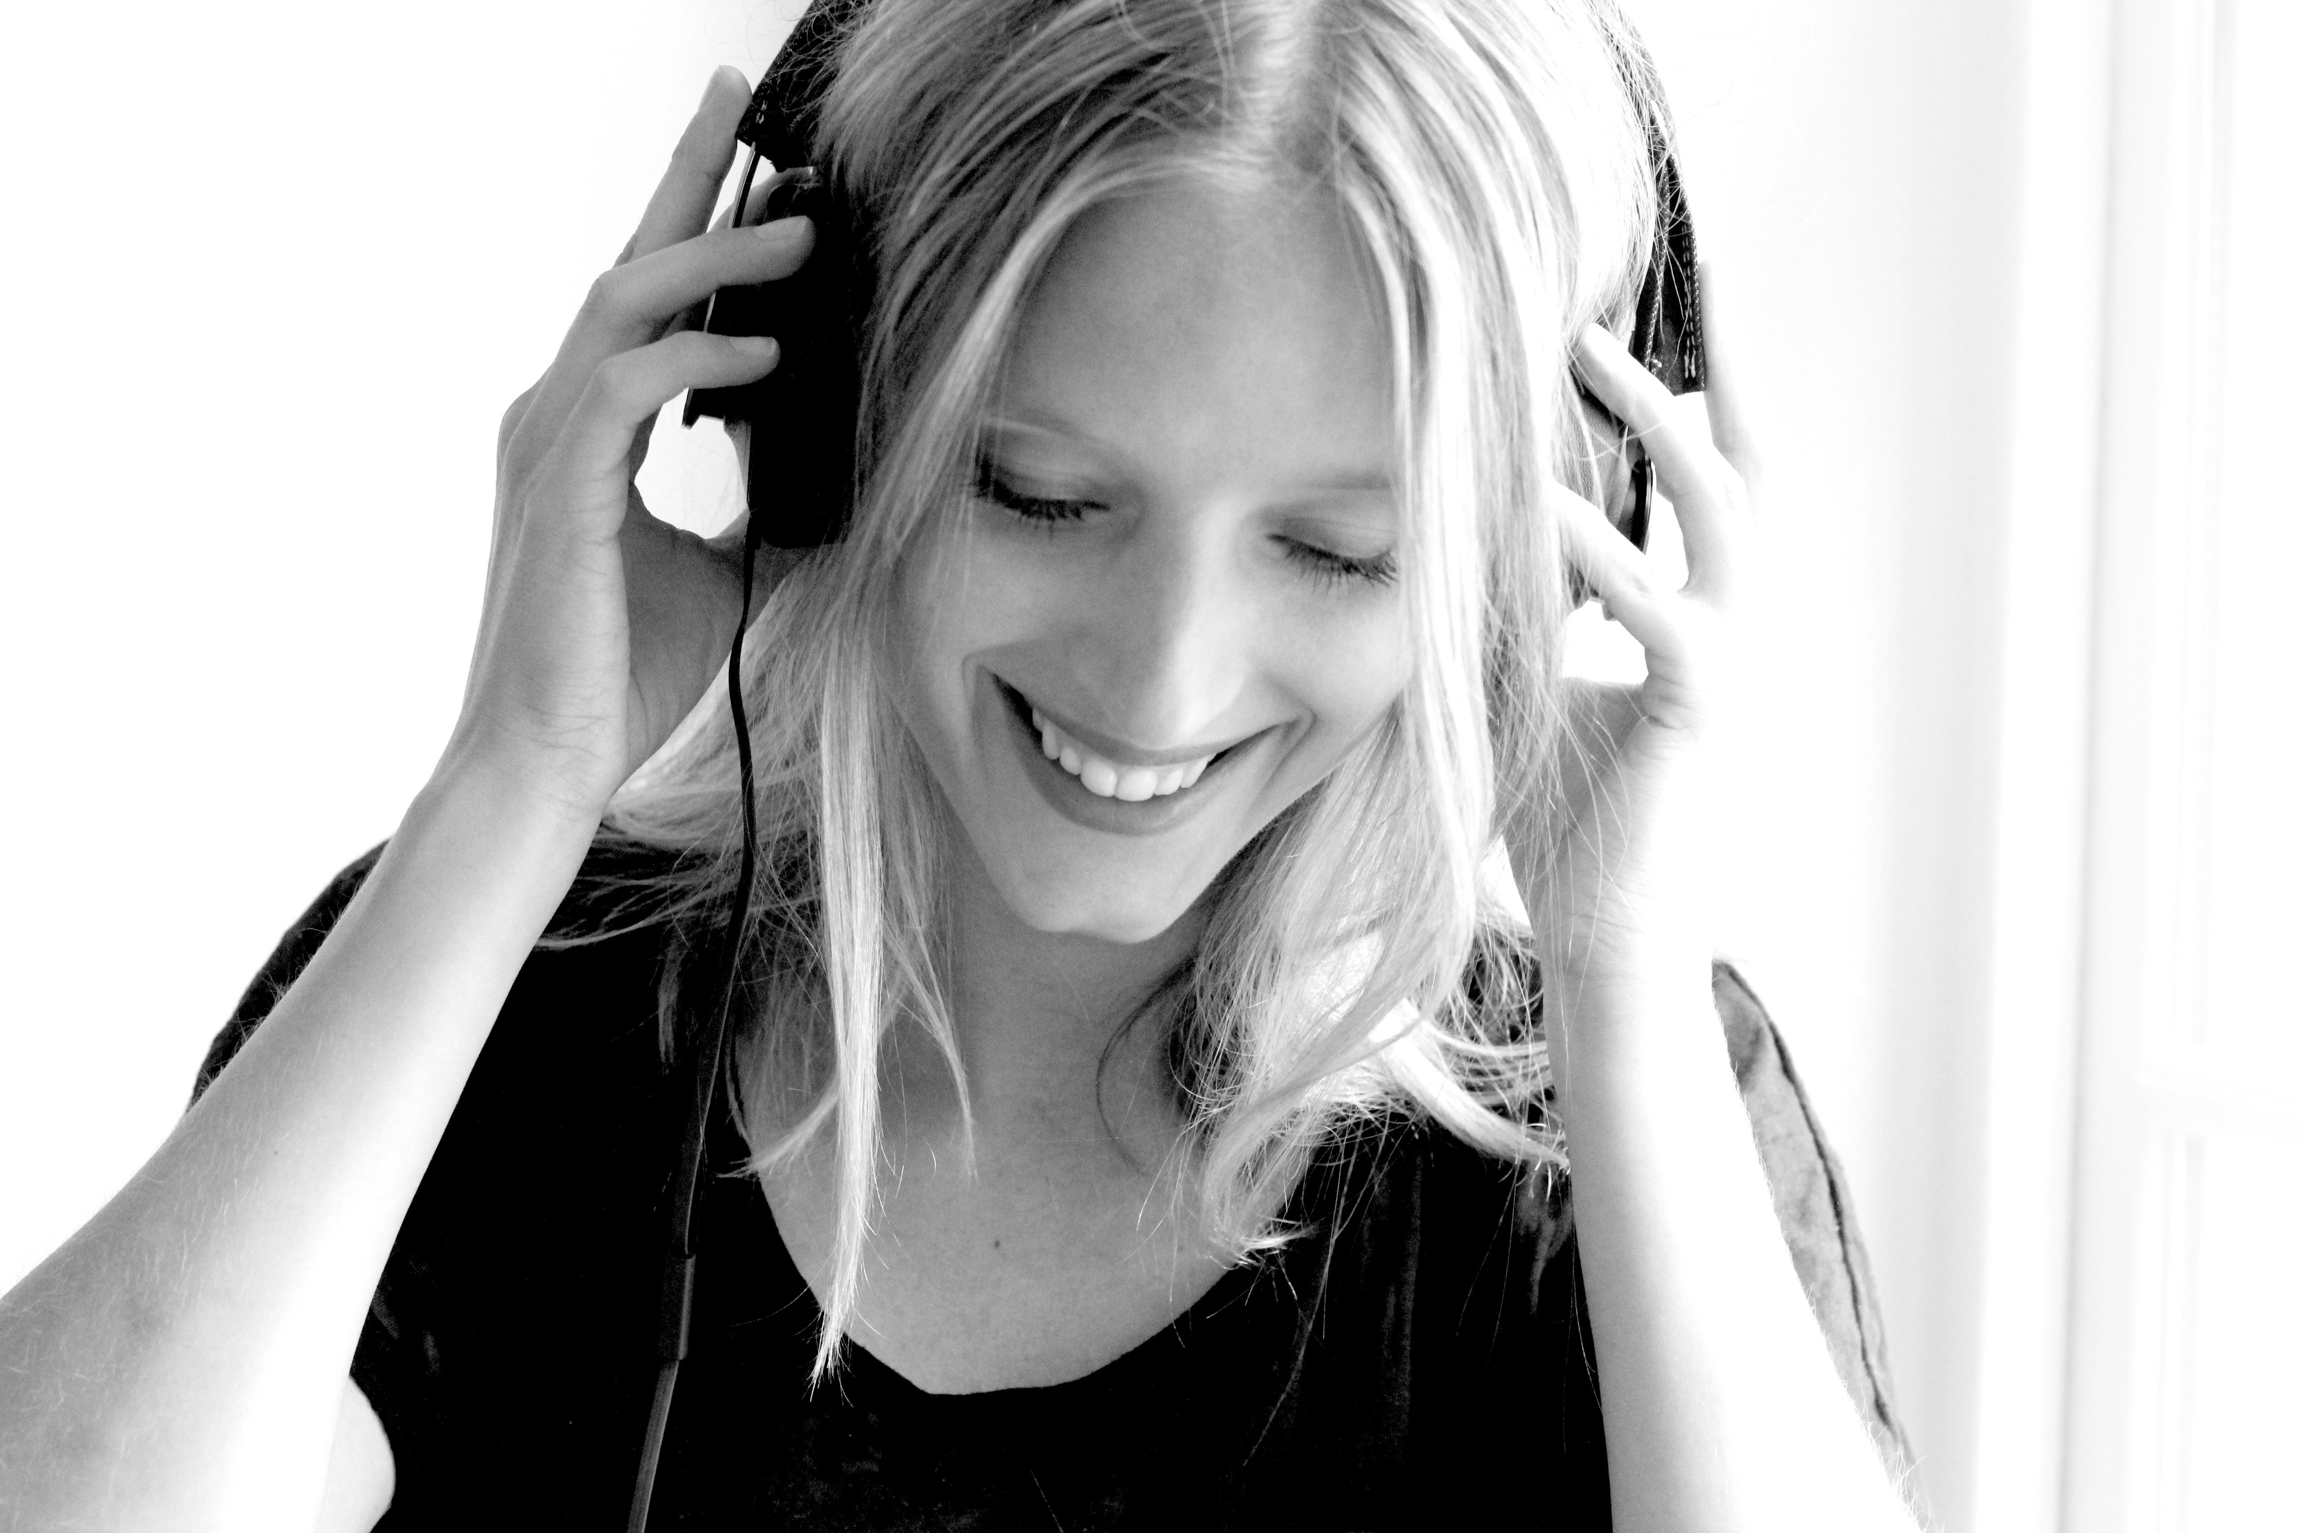
#10 – Listen to Music
This Photo by Unknown Author is licensed under CC BY-NC-ND

Slide 21
If you’re in a bad mood, try this . . .
Listen to 3 songs:
A song that matches your energy
A neutral song
A song that feels positive & uplifting
Example: If you feel sad or depressed, listen to songs in this order:
A slow, sad song
A song in between happy & sad
A song that is happy with a fast beat

Slide 22
#11 – Limit News Watching

Slide 23
Should we watch the news?
It is good to stay informed, but there is no need to constantly check the news.
If you feel stressed or anxious, take a break from the news and do something fun.

Slide 24
#12 – Remember this won’t last Forever

