Slide 1
KINDNESS WEEK

Slide 2
Kindness Week
- January 25th through January 29th

Slide 3
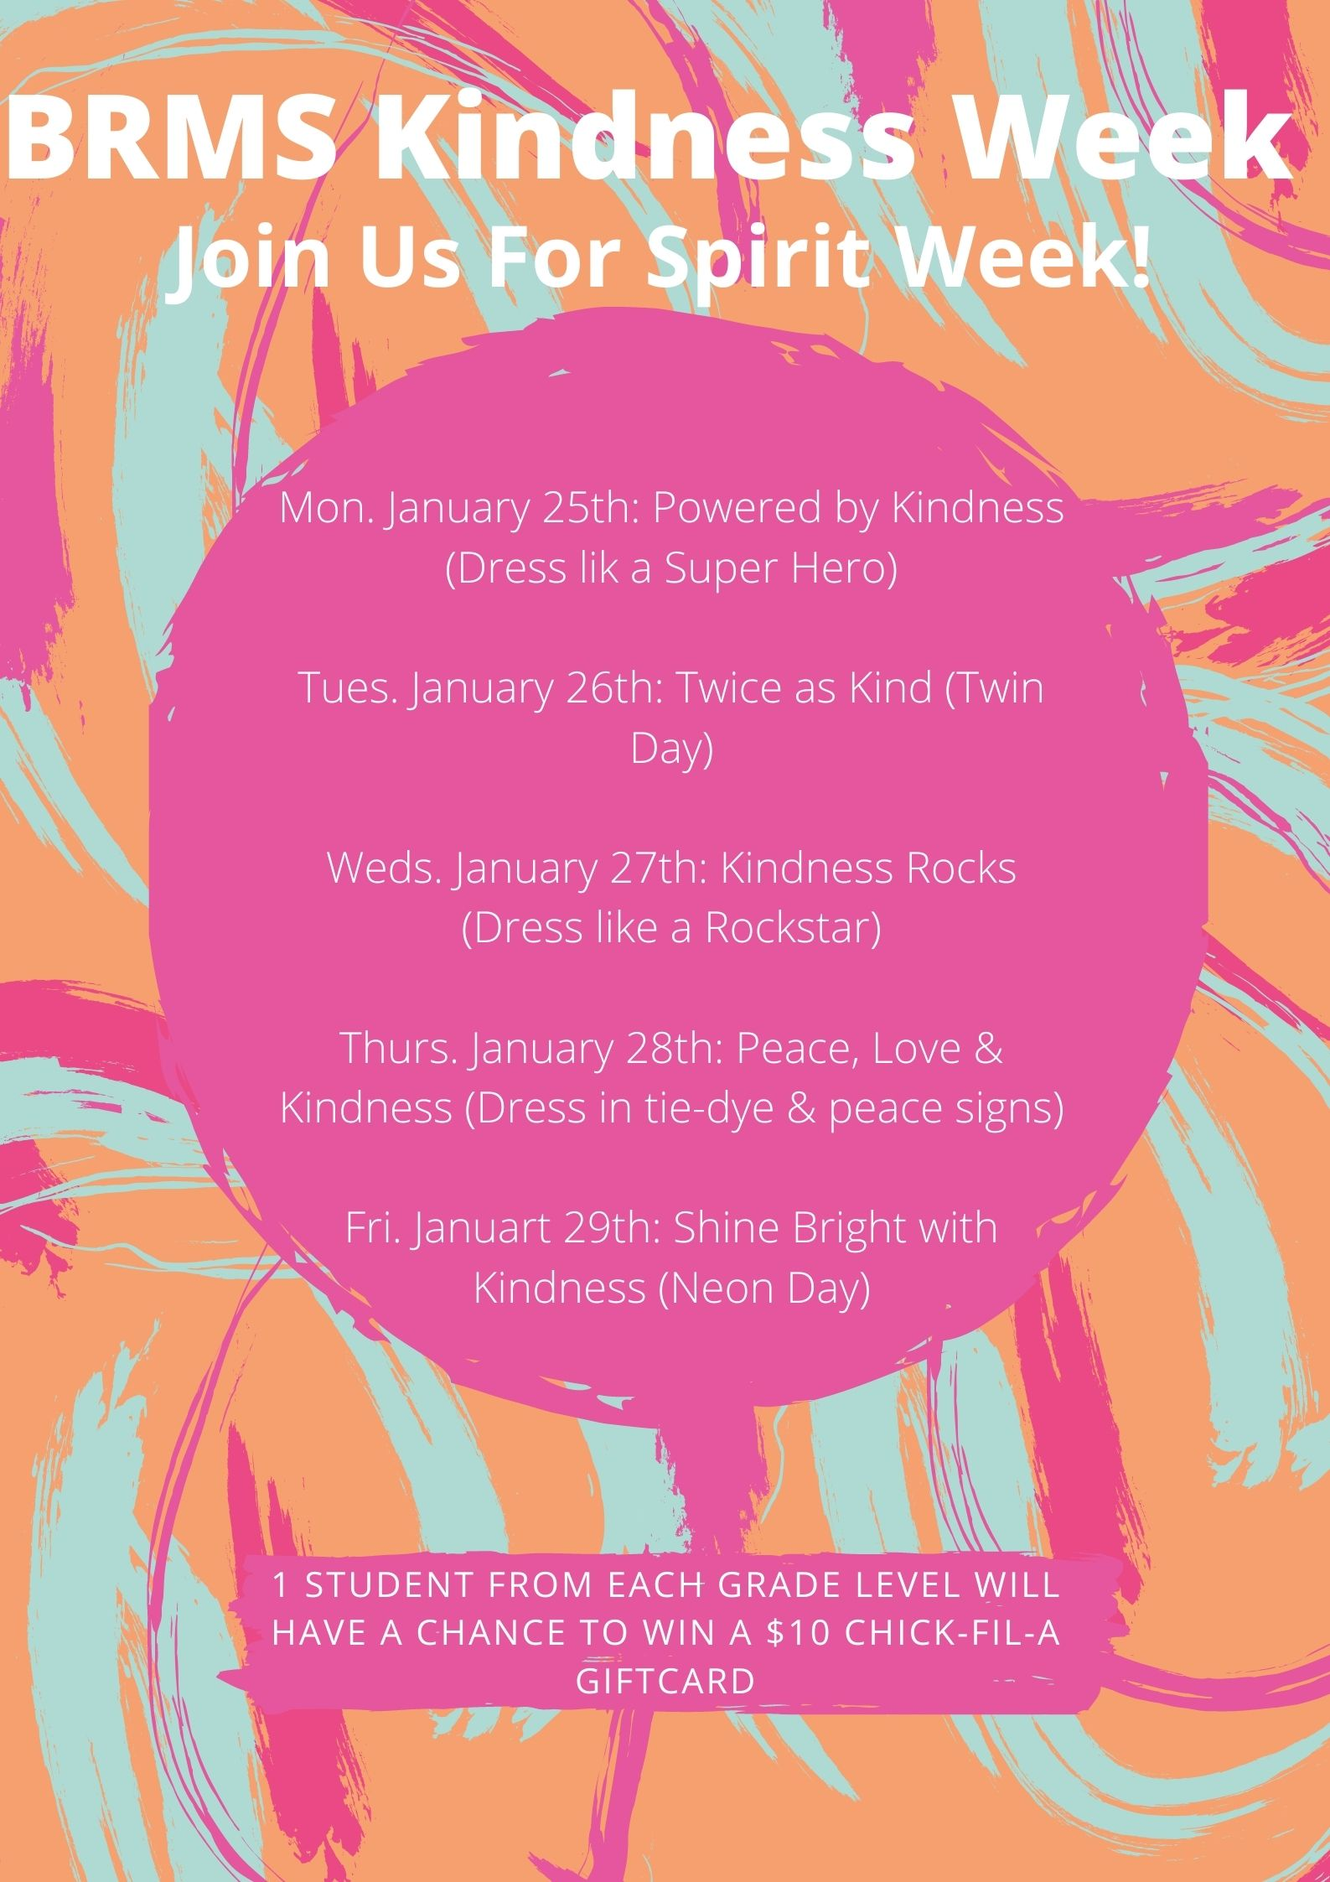
KINDESS WEEK SPIRIT DAYS

Slide 4
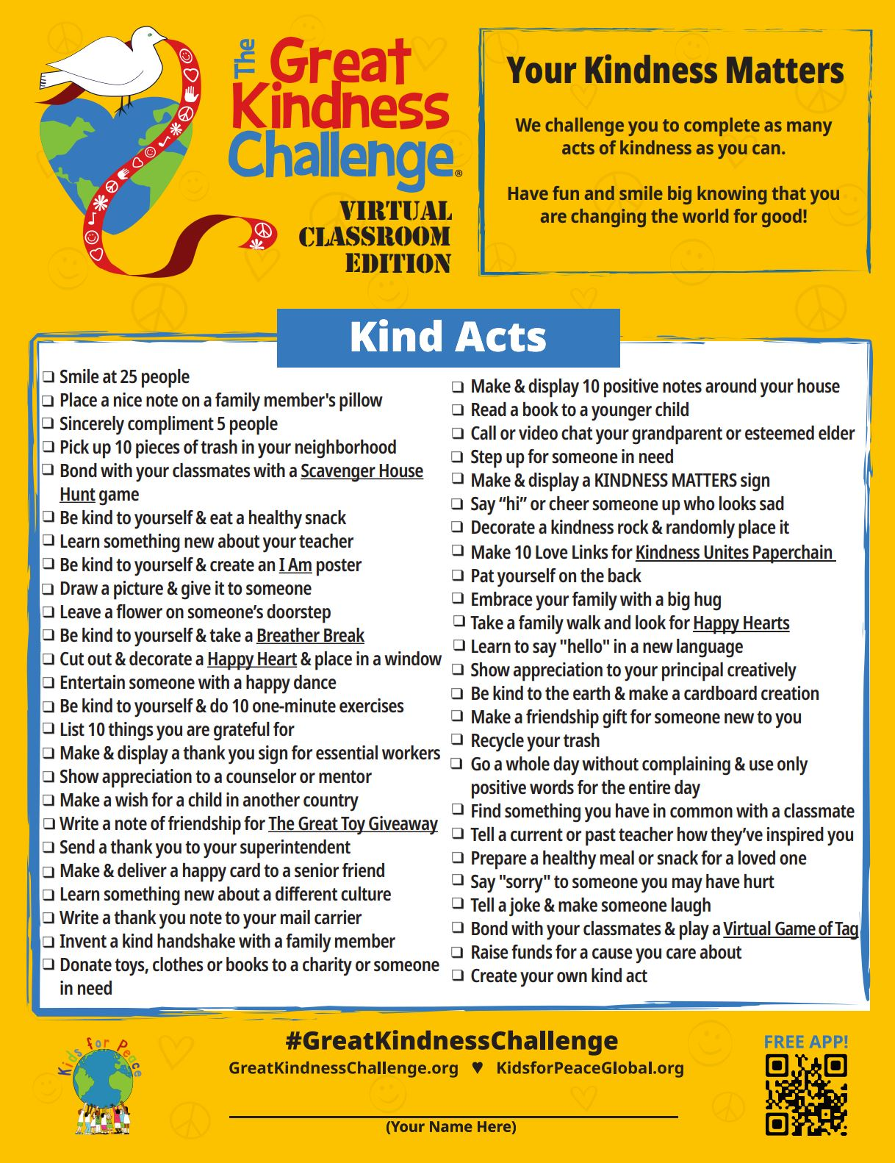
KINDNESS CHALLENGE
- 3 students (1/grade level) with the most challenges checked off by the end of the week and signed by a parent or teacher will win a $10 Chick-Fil-A gift card

Slide 5
ILT KINDNESS WEEK ACTIVITIES
January 25th
Great Kindness Challenge Check List handed out to every student
January 26th
Eagles Pledge to Spread Kindness: Heart Handout
January 27th
Thank You Notes to Soldiers
January 28th
Appreciation Wall
January 29th
Thank You Notes to someone important in your life

