Slide 1
Character Word of the Month
November 2020

Slide 2
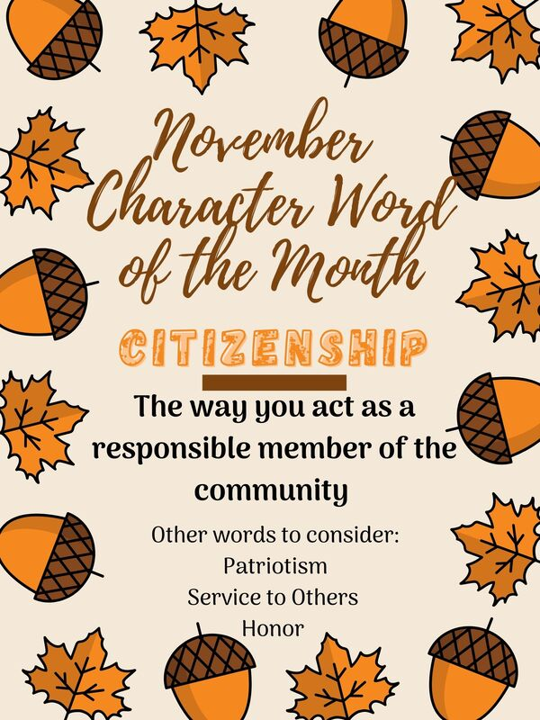
Citizenship
Why is CITIZENSHIP important?
How does CITIZENSHIP impact our everyday life?

Slide 3
Video
https://mcsd.connectwithkids.com/character-life-skills/
Please click on the middle video in the first row (Citizenship)

Slide 4
Discussion
What do you think are the most important components or elements of citizenship?
What can be difficult about behaving Ben’s way?

