Slide 1
Character Word of the Month
February 1st, 2021

Slide 2
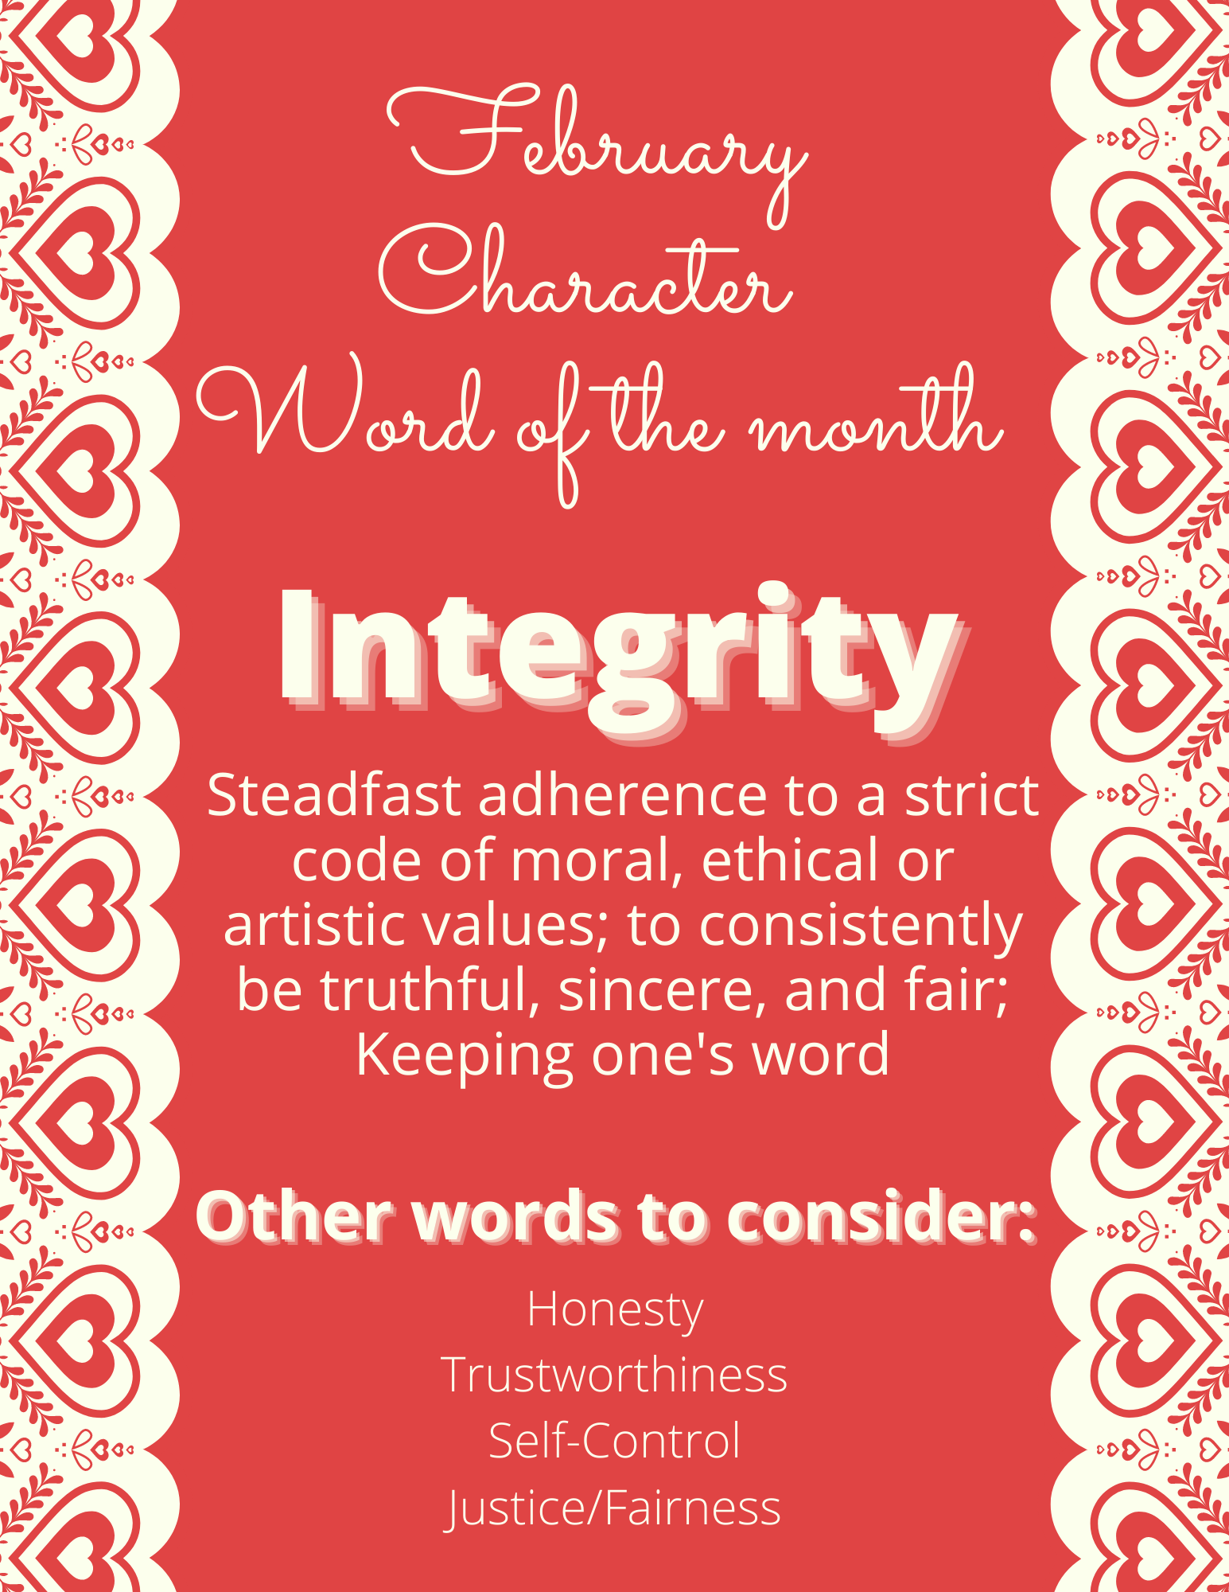
Definition & Other words to consider

Slide 3
Discussion
What does integrity mean to you?

Slide 4
Video
https://mcsd.connectwithkids.com/character-life-skills/
Please play the INTEGRITY video (the 5th video in the middle row)

Slide 5
Discussion
One of the students in the Integrity video says that you should model all your actions around being a role model. Do you think it matters what you do in private? Why or why not?
What does integrity have to do with leadership? Can you be an effective leader without it? Why or why not?
Does power corrupt?

