Slide 1
Welcome, Class of 2024!
Important Information from the Columbus High School Counseling Office

Slide 2
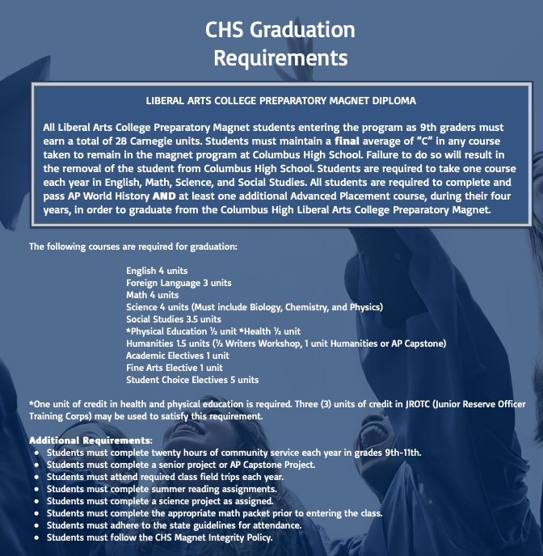

Slide 3
We Are Available For:
Academic Planning and Class Selection Guidance
College and Career Planning/Preparation
Social/Emotional Conflicts/Concerns
How to Contact Your Counselor:
Visit during the school day.
You must retrieve a pass from your teacher first and then check-in upon entering the counseling office.
Make an appointment to meet before or after school through email or face to face.
For an urgent matter which requires immediate attention and cannot be addressed through the other methods, you may come in to see your counselor at anytime.
We strongly encourage you to meet with your counselor often.

Slide 4
4-Year Success Tips

Slide 5
Why is Attendance Important?
Achievement: Missing one day at CHS is equivalent to missing 2-3 days of instruction. Students who attend school regularly are more likely to pass classroom and standardized tests than students who do not.
Opportunity: Having good attendance gives you an opportunity to learn important information that will help you build a successful academic record.
Being part of the school community: Just by being present at school, you are learning how to be a good citizen by participating in the school community, learning valuable social skills, and developing a broader world view.
If you are absent for any reason, please make sure that you communicate with your teachers or have your parents communicate with your teachers. You are responsible for any missed assignments, quizzes, and or tests. Upon return, you are required to bring either a parent note or a medical note from a professional. (Please see handbook for further details on attendance).

Slide 6
Monitor your Grades
Communicate with your teachers
Check your grades regularly on Infinite Campus
Maintain a Healthy Lifestyle
Get adequate sleep, eat nutritious foods, and have a balance between home, school and your social life.
Get involved in school activities (clubs, athletics, community service etc.)
Maintain Good Grades
Your grades should be an accurate reflection of your abilities.
Reasonably challenge yourself. Be careful not to take on more than you can handle.
Seek help when needed (attend teacher/peer tutoring hours, form study groups, consult with your counselor).
Important things
to remember

Slide 7
Have a binder for each class.
Have sections within each binder for:
Homework to complete.
Completed work to turn in.
Classroom notes and study guides.
Organization

Slide 8
Ask yourself:
Do I have my textbook?
Do I have my binder?
Do I have my pen / pencil?
Do I have my completed homework?
Preparation

Slide 9
Use your daily planner to log tests, quizzes, and homework assignments.
Schedule a routine time to work on homework assignments.
Study for upcoming tests a dividing it up a little each day to avoid overnight cramming and panic-prep.
Time Management

Slide 10
Start a clean sheet for each day’s notes.
Write subject and the current date at top of each sheet.
Write down important facts from class.
Be an active listener.
Make sure to have your note taking materials with you.
Pens / pencils
Paper
Be creative!
Note Taking

Slide 11
Try to avoid procrastination. Break up big projects into smaller tasks and get started.
Do your homework to learn and not to get finished.
Think about what you need to do first. Don’t leave everything for the night before!
Homework

Slide 12
Be engaged in class—then when you are studying, you’ll get a lot more out of it.
Ask questions for clarification and understanding.
Be sure to know and understand assignments and what material is important to know for tests and quizzes.
AVOID TECHNOLOGY DISTRACTIONS
Spend 10-15 minutes each evening reviewing notes and material from each class.
Complete all homework and turn it in on time.
Study Skills

Slide 13
Know the dates of upcoming tests and quizzes; you should have these written in your planner.
Study notes and classroom materials for 10-15 minutes each evening instead of waiting until the night before a test.
Come prepared on test dates:
Having studied important information.
Bring pens or pencils with you.
Get plenty of sleep the night before.
Relax and recall all the material you studied.
Test Taking

Slide 14
Biology Advice from Your New Teachers
Keep in Mind the Following Things:
Biology, like most sciences, is hands-on and application. Most of us learn best when we are actively participating in a topic. So make sure to pay attention in biology lab sessions. There is a lot of reading. This requires you to study textbook material.
Compare biology notes with a friend during a study session. Since much of biology tends to be abstract, have a "note buddy." Each day after class compare notes with your buddy and fill in any gaps. Two heads are better than one!
Don't cram! As a rule, you should start studying for biology exams a minimum of two weeks prior to the exam.
Study guides do NOT contain questions that will appear on the test. They are study guides.
Attend all available tutoring sessions.

Slide 15
Math Advice from Your New Teachers
Keep in Mind the Following Things:
Complete ALL of your summer math packet. It is worth several test, quiz, and homework grades. The summer math packet will be graded and will be your first math grades upon entering CHS.
Ask questions in class if you are having a difficult time understanding concepts and or instruction.
Establish a consistent, organized homework routine.
Prepare for quizzes and tests early.
Consistently communicate with your math teacher and attend available tutoring sessions.

Slide 16
Questions?

Slide 17
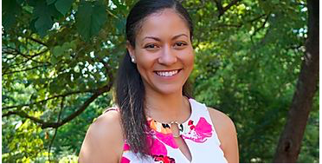
Counselor Contact Information
Dr. Christopher Porch, Counseling Director
Last Names P-Z
Porch.Christopher.A@muscogee.k12.ga.us
Ms. Shella Scott
Last Names H-O
Scott.Shella.N@muscogee.k12.ga.us
Mrs. Dominique Thomas
Last Names A-G
Thomas.Dominique.R@muscogee.k12.ga.us

