Slide 1
Being a good friend
September 24th, 2020

Slide 2
Friend:
A person who has a strong liking for and trust in another person

Slide 3
What does being a good friend mean to you?

Slide 4
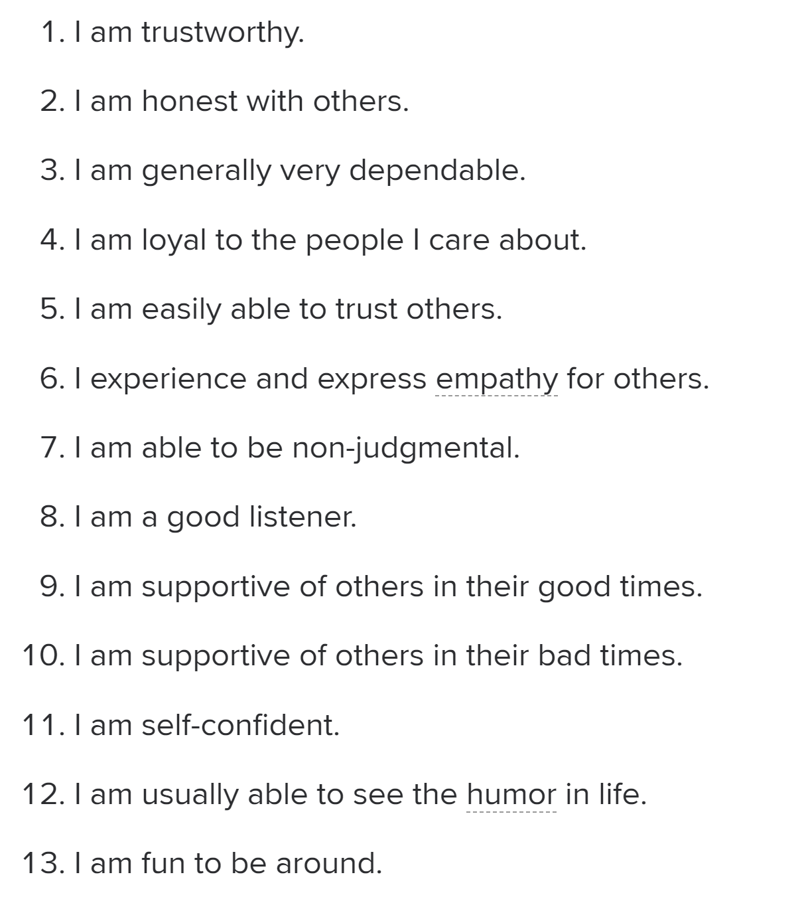
How much do you agree with each statement?

Slide 5
13 Essential Friendship Traits
Trustworthy
Honest with others
Dependable
Loyal
Trusting
Empathetic
Non-judgmental
Good listener
Supportive during good times
Supportive during bad times
Self-confident
Humorous
Fun to be around

Slide 6
Which friendship traits mean the most to you?

Slide 7
Which friendship traits can you use some more progress in?

